Slide 1
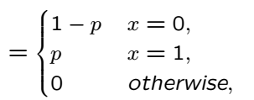


Bernoulli PMF
Bernoulli(p) RV takes on values 0 or 1
Same RV regardless of experiments producing
{0,1}
{H,T}
{Accept,Reject}

Slide 2

Binomial PMF
n indep. coin flips, p is prob. of success; how many successes?
Binomial (n,p) RV takes on values {0,1,…,n}
Can be viewed as a sum of n independent Bernoulli RVs

Slide 3
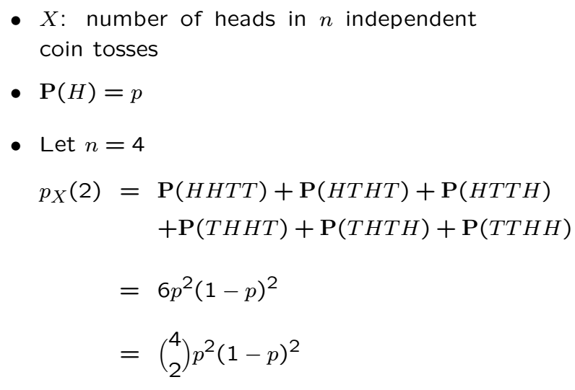

Binomial PMF Cont’

Slide 4

Recall Geometric PMF

Slide 5





Pascal PMF
Let L be the number of trials until k rejects
“reject” same as “heads”
p is probability of reject in each trial
Generalization of geometric PMF

Slide 6
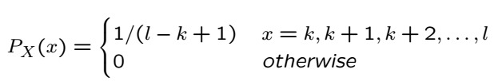
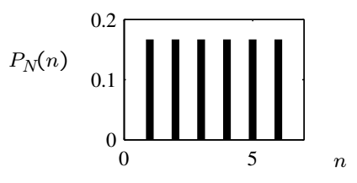

Discrete Uniform RV
Equiprobable on consecutive integers k, k+1, …,l
Roll a fair die and observe the number of points

Slide 7

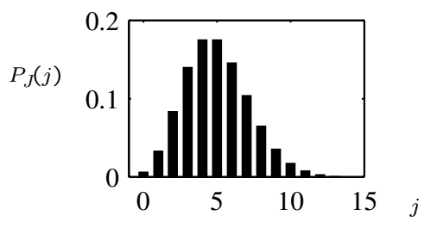
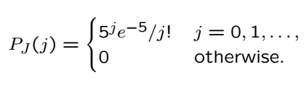
Poisson PMF
Used to model number of random arrivals in time interval
Example: Calls arrive randomly at 0.25 calls/sec
The PMF of number of calls in a 20 sec. interval?

Slide 8
Acknowledgements and Citations
Parts of these slides are adapted from the following resources:
Power Point Lecture Slides for the Textbook http://bcs.wiley.com/hebcs/Books?action=index&bcsId=8676&itemId=1118324560
John Tsitsiklis. 6.041 Probabilistic Systems Analysis and Applied Probability, Fall 2010. (Massachusetts Institute of Technology: MIT OpenCourseWare),http://ocw.mit.edu (Accessed 13 Apr, 2015). License: Creative Commons BY-NC-SA

